Slide 1

Fortify
J
O
I
N

Slide 2

what is fortify?
Here at Project Fortify, we strive to create a platform to connect volunteer cyber security professionals with organisations that need help strengthening their cyber security. Fortify provides a specific focus on delivering cyber security assessments and cyber strategy mechanisms to small businesses/organisations and non-profit organisations
Fortify – ‘a matchmaking tool for experience’
We live through our motto here at Fortify! We connect you with relevant organisations where you can showcase your skills, knowledge and experience. Join today and kickstart your career in cyber-security or enhance how versatile and tech-savvy you can be!
By collaborating in our widespread projects and team-based meetings here at Fortify, you provide yourself with the opportunity to bring the best-version of yourself to a professional environment!

Slide 3

What makes fortify stand out?
What are our values?
Raising Awareness in relation to cyber threats and the need for comprehensive security initiatives.
Making Australia Safer : By creating a vibrant marketing implementable nationwide, Fortify is making Australia a safer country to invest and do business in.
Unparalleled real-word Experience: Providing our volunteers with the opportunity to not just showcase their cyber-security skillset, but also network with other like-minded cyber security professionals, and attain unparalleled real-world experience in the I.T field.
What is our mission statement?
‘Connect, Assess, and Secure Your Business with Our Cyber Security Professionals’. We export our mission statement to all our prospective potential clients!
How can you help fortify succeed in its mission?
Here at Fortify, we market ourselves to a wide range of students with many underlying skillsets and talents. All students who resonate with the values of Fortify are encouraged to join!

Slide 4
WHY JOIN Fortify? Explore our many exciting teams!
Fortify offers an exciting landscape for prospective junior students! Our dynamic structure offers our team members to join teams who are more tailored to their specific skillsets! Each team offers a unique range of projects and collaborative groups students will be able to assign themselves to!
Research & strategy [R&S] team
Development team
Ui / Ux TEAM
Research and develop marketing and advertising material for prospective client organisations and cyber security volunteers.
Continue creating and refining legal documentation, to ensure the Fortify is compliant with Australian standards and regulations.
Continue developing and refining the cyber security assessment questionnaire and scoring matrix.
[
Create a functional prototype of the website in Figma.
Collaborate with the Research & Strategy team to design and prototype critical website functionality.
Continue to iterate on design work from the previous trimester.
Merge the 2 projects (front-end and backend) togerther and move it into SourceTree.
Integration of the 2 fronr-end and backend (we foresee that this will consume a lot of time doing research/upskilling and testing)
Implement login/logout functionality

Slide 5
What work will I be doing?
Explore our exciting ongoing projects
Research & strategy [R&S] team
Working within the Research & Strategy team, the marketing team have engaged in activities involving developing marketing plan for creating awareness of Fortify company with the objective of connecting volunteer cyber security professionals with organisations that need help strengthening their system security, by addressing security issues and gaps in cyber security awareness. Fortify is targeted towards small businesses and non-profit organisations that do not have the adequate resources to field dedicated cyber security teams, and it is our overall goal to provide a platform for our volunteers to both advertise their cyber security expertise, as well as develop security controls and models that are needed.
R&S Marketing team
Working within the Research & Strategy team, the Legal sub team engaged in objectives with relevance to the legal documentation of Fortify and all parties involved. This included members finalising and separating the ‘Terms and Conditions’ and ‘Privacy Policy’ sections into separate documents, which are expected to be integrated into the Fortify website in future trimesters. The sub team also worked on researching and completing the first draft and version of a client contract/agreement between experts and volunteers of the Fortify service.
r&s Legal team
[Creating an induction form for volunteer cyber experts to initially fill out on the website.
Create an assessment interview process for Fortify consultants to better understand/vet/approve or deny applicants.
Creating a full end-to-end Customer and Volunteer Process. Creating a Prototype for back-end dashboard for Fortify consultants to better visualize the experts and clients on hand
R&S questionnaire team

Slide 6
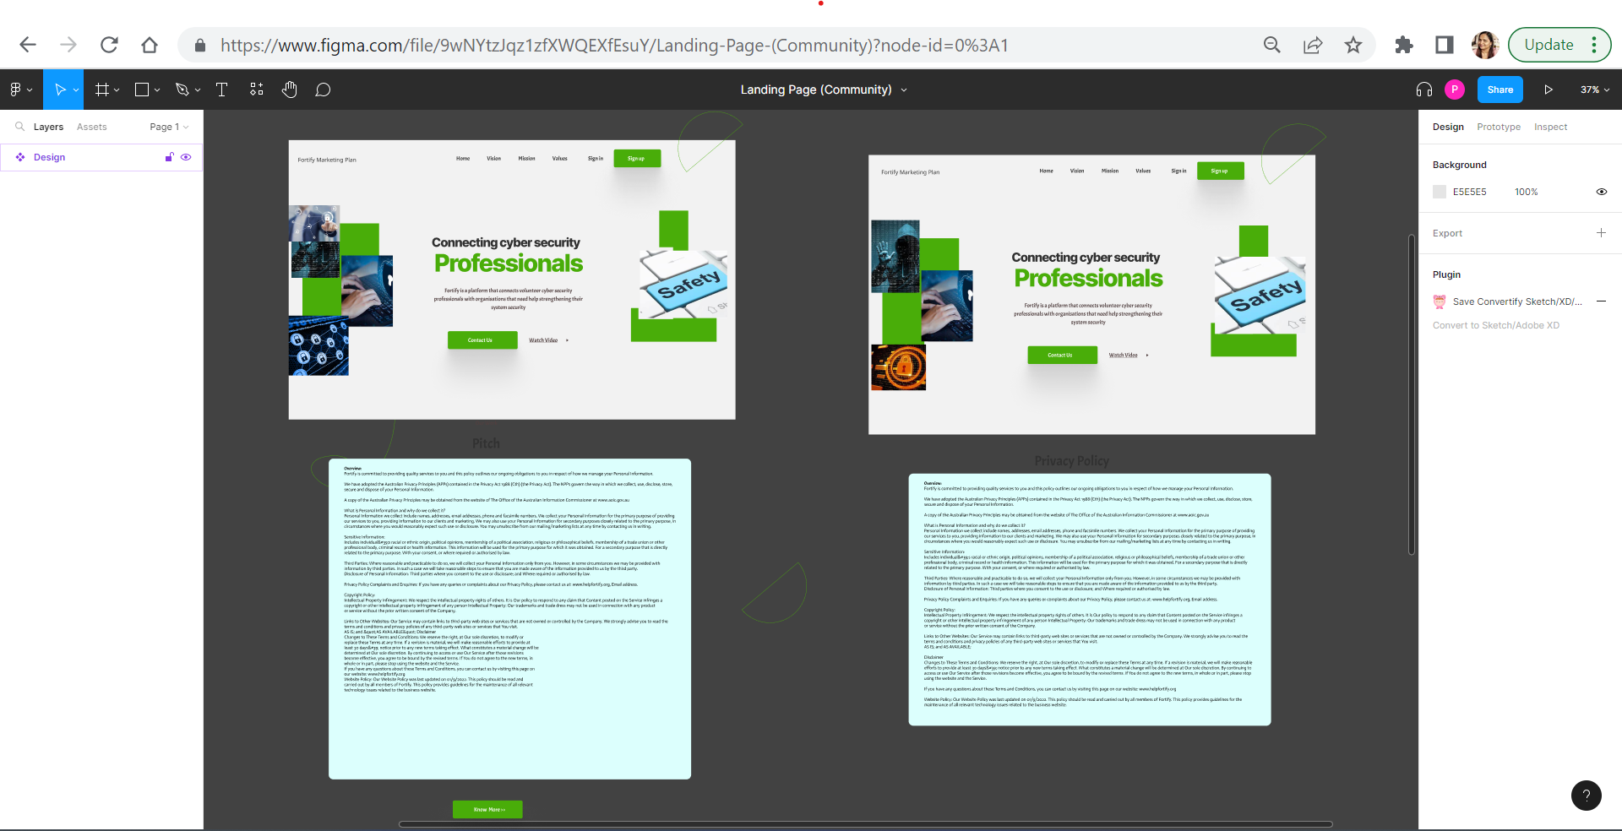
What work will I be doing?
Explore our exciting ongoing projects
Research & strategy [R&S] team- Landing Page Prototype
Link: https://www.figma.com/file/9wNYtzJqz1zfXWQEXfEsuY/Landing-Page-(Community)?node-id=0%3A1

Slide 7

What work will I be doing?
Explore our exciting ongoing projects
Projects- FORTIFY WEBSITE DEVELOPMENT
Merge the 2 projects (front-end and backend) togerther and move it into SourceTree.
Integration of the 2 front-end and backend (we foresee that this will consume a lot of time doing research/upskilling and testing)
Implement login/logout functionality

Slide 8

What work will I be doing?
Explore our exciting ongoing projects
Projects- DEVELOPMENT OF MOCKUP Design
Create a functional prototype of the website in Figma.
Collaborate with the Research & Strategy team to design and prototype critical website functionality.
Continue to iterate on design work from the previous trimester.

Slide 9
WAY FORWARD
Research & Strategy Marketing Team Plan Way forward:
Detailing selection criteria for becoming a volunteer as well as organizations seeking help.
Detailing step by step process process for completion of activity both for volunteers and organizations
Adding social media links for creating awareness and gathering feedback.
Research & Strategy Questionnaire Strategy way forward:
Customer Process mockup by design team
Other pages/resources useful to customers such as FAQ pages, links to ACSC pages, blog resources etc.
Liaise with Design and/or Database team on Back-End Dashboard Prototype
Customer Feedback system post-job
Research and demonstrate some potential use cases/examples
Research and create cyber strategy for Fortify company
Research & Strategy Legal Plan Way forward:
Emailing clients, creating the email and establishing an agreement with the contract that was made.
Implementing cyber risk plan from the cyber risk document, using this to find suitable clients.
Tweaking both contract and privacy policy in accordance with future amendments of Fortify’s direction.
Uploading the finalised/updated versions of the privacy policy and terms of agreement into the Fortify website.
UI/UX Team and Development Team Plan Way forward:
Continue to develop mockup design and work towards development of fully functional FORTIFY website
Step one
[]
Step two
[]
Step three
[]

Slide 10
SUMMARY
Come and join us today for a fulfilling career at FORTIFY
Our vision at the Fortify marketing team is to create a brand-new platform that markets the core values of Fortify as a company to the organisations/business's/institutions that need them most and is to give small businesses and organisations the ability to assess their current security posture and improve their security capabilities by connecting them with professional volunteers who can further spread awareness of cyber security practises. By doing so, we also provide our local cyber security professionals with the opportunity to network and broaden their skillsets.
WE NEED YOU to SUPPORT our VISION of supporting small businesses survive by helping them to prevent potential cyber-attacks and also assist victims of cyberattacks to rebuild their businesses.

